Slide 1
Systematic Investment Strategy – “The Bouncing Ball”
- Junxing Zhou, Xinyu Xiong, Yi Ding

Slide 2
Overview
Strategy Objective:
This strategy dynamically adjusts asset allocation using two key signals—the Bias-UMD signal and the Recession signal—to enhance portfolio performance. By leveraging market dynamics and macroeconomic insights, the strategy aims to capture growth opportunities while mitigating risks during economic downturns.
Catalogue
Portfolio Construction: Signal 1
Portfolio Construction: Signal 2
Strategy Execution
Backtest
Performance Evaluation

Slide 3


Signal 1 - Bias-UMD (Intuition)
Intuition: Imagine a ball shot into the air. Its height (BIAS Z-score) and speed (Momentum) determine whether it will continue rising or begin falling. This signal dynamically measures the market's upward or downward momentum and adapts based on volatility.
In this strategy, Bias Z-Score indicates whether the market is sufficiently “cheap” or “expensive” relative to its recent trend and volatility to warrant a more aggressive buying/selling posture. The current momentum comparing with its 60-day moving average captures the growing or decreasing trend of momentum.
A Sell signal occurs when the price is too expensive and exhibits a dropping momentum trend.
Sell
A buy signal occurs when the price is too cheap and exhibits a growing momentum trend.
Buy

Slide 4
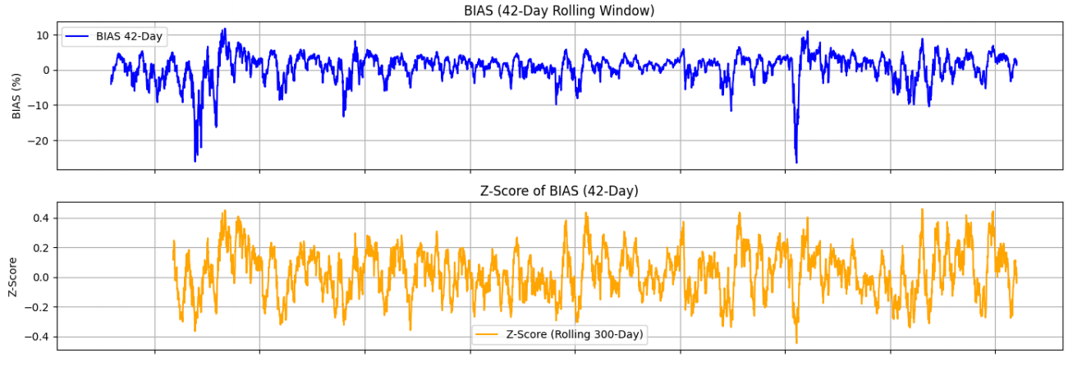
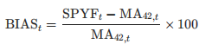
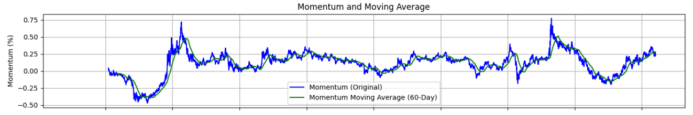
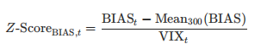
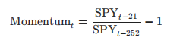
Signal 1 - Bias-UMD (Construction)
Key Matrices Calculations
BIAS:
BIAS Z-Score:
To standardize BIAS, we used VIX instead of rolling variance of BIAS, which is a better proxy of market volatility.
Momentum:
Buy Signal
The SPY is at very cheap price: BIAS Z-Score < -0.2
Momentum is growing: Momentum > MA (Momentum) + 0.05
Sell Signal
The SPY is at very expensive price: BIAS Z-Score > 0.2
Momentum is growing: Momentum < MA (Momentum) - 0.05

Slide 5
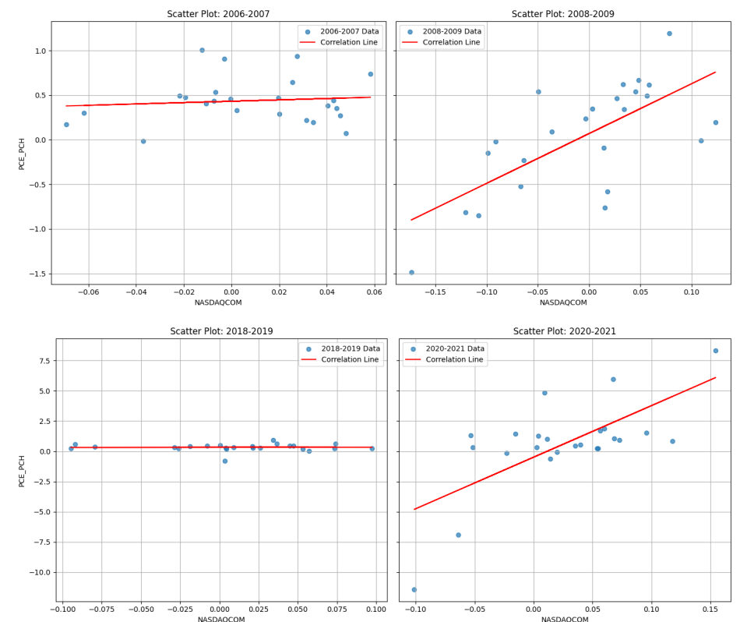
Signal 2 – Recession Signal (Intuition)
Intuition:
Inspired by recent analysis from economist Gao Shanwen on China’s economy, where the correlation of housing price and consumption increased rapidly after COVID-19 (China economic recession)
The macroeconomic interpretation is that during recession people become more risk averse due to uncertainty and less confidence about the future. Hence a decrease in household property easily drives down the consumption.
This strategy builds on the observed relationship between equity markets and consumption during economic downturns.
During periods of economic stress, such as the 2008 financial crisis and COVID-19, equity market performance displayed a stronger correlation with personal consumption expenditures (PCE).
High Correlation During Market Distress

Slide 6

Signal 2 – Recession Signal (Construction)
The Recession Signal captures this relationship through rolling correlations between NASDAQ prices and PCE growth. By identifying periods of increased correlation alongside declining equity prices, the signal effectively flags early-stage recessions.
From the graph, the rolling correlation usually peaks at the early stage of recessions.
Key Matrices Calculations
Rolling Correlation (NASDAQ and PCE):
A Recession Signal is triggered when:
High correlation between stock price and consumption: Rolling Correlation > 0.4
NASDAQ Price exhibits a decline in the past month

Slide 7

Strategy Execution
Daily Bias-UMD Adjustments:
Positions are dynamically adjusted based on the Bias-UMD signal. Adjustments occur the day after a signal is generated.
Buy Signal: SPY position increased to 300%
Sell Signal: SPY position reduced to 25%
Recession Adjustments:
Recession signals rely on monthly PCE data, typically released at month-end. Adjustments occur at the start of the second month after the recession signal:
Upon triggering a Recession Signal:
Reduce SPY holding to 0%
Allocate 15% to volatility assets (f90) for 42 trading days
Both signals triggered: Followed the recession adjustments
Portfolio Returns:

Slide 8
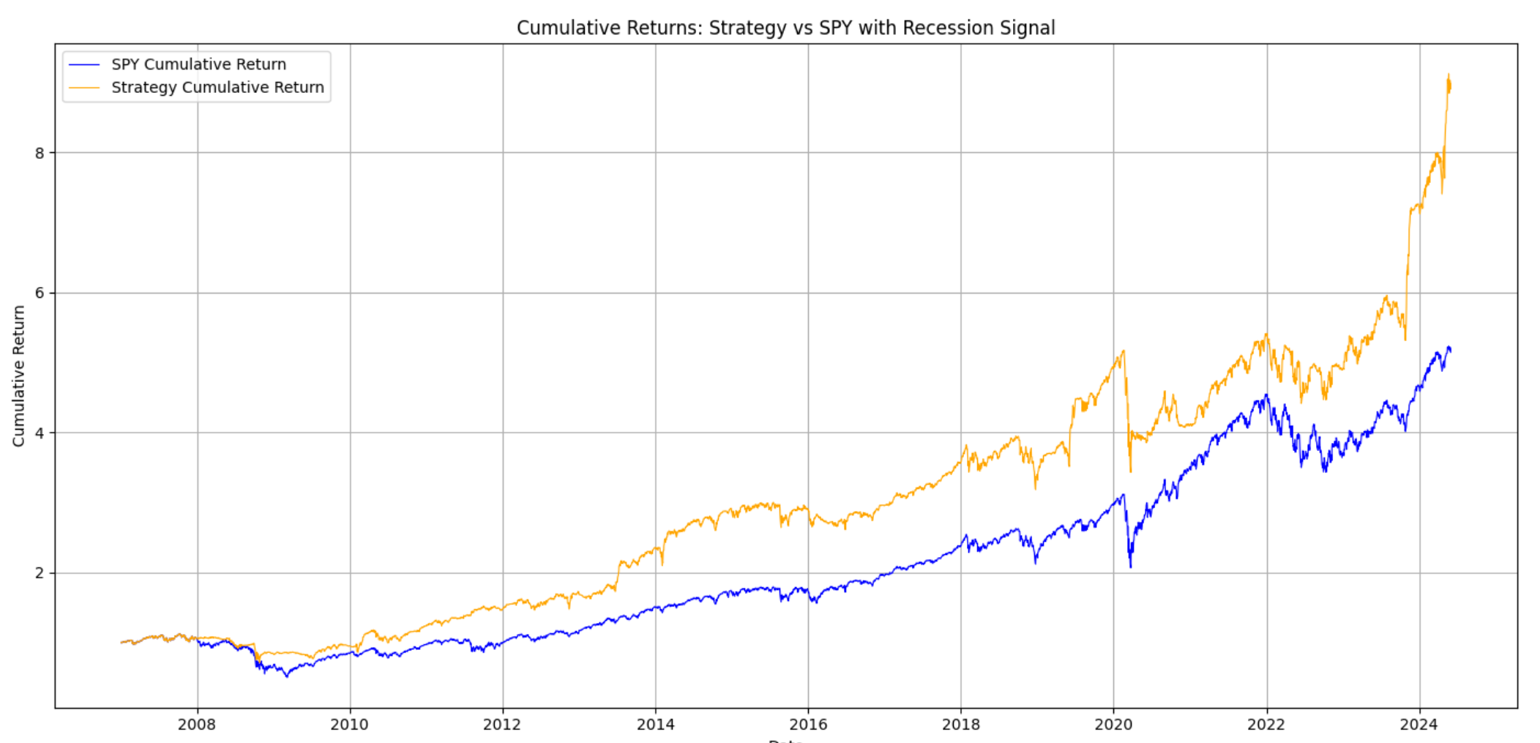
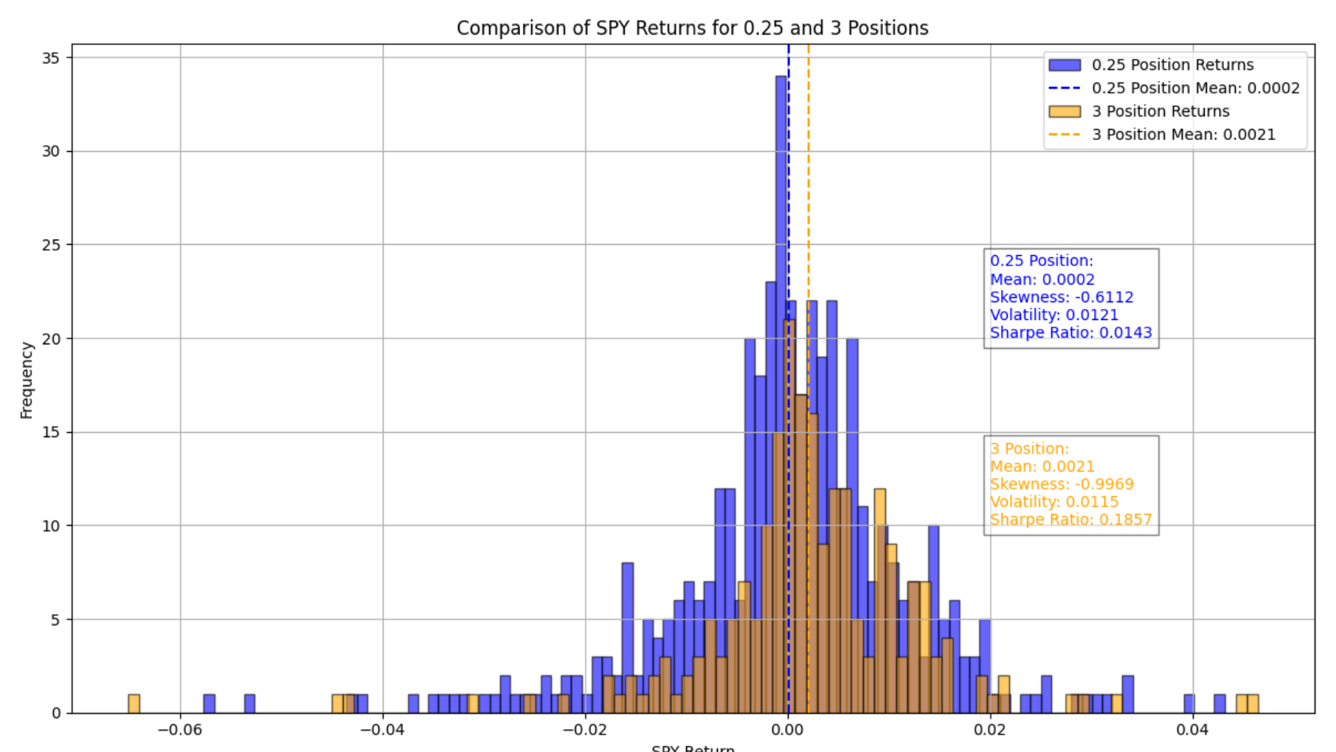
Backtesting Performance Evaluation
Asset | Annual Return | Volatility | Sharpe Ratio | Sortino Ratio | Max Drawdown | Skewness
SPY | 0.0455% | 1.26% | 0.575 | 0.701 | -70.0% | -0.071
Strategy | 0.0561% | 1.1% | 0.811 | 1.001 | -41.6% | 0.248
Significant difference of return when holding 300% and 25% position of SPX, indicating that the Bias-UMD signal is valid.

Slide 9
Performance Evaluation Discussion
Advantages & Attractive Properties
Limitations
Improved Momentum Strategy:
Compared to traditional momentum strategies, this model incorporates the BIAS metric to avoid buying when prices are excessively high, thus improving timing and reducing the risk of overpaying in overheated markets.
Optimized VIX Hedging:
Unlike conventional VIX hedging strategies that often incur high long-term costs, this model establishes clear signals to identify optimal periods for VIX allocation, minimizing unnecessary expenses while maintaining effective risk protection.
Strong Theoretical Foundations:
Beyond quantitative performance, the model is grounded in macroeconomic theories such as risk aversion and wealth sensitivity. These principles provide deeper insights into market behaviors, especially during recessions and periods of heightened uncertainty.
Signal Lag:
Recession signals rely on delayed macroeconomic data, missing early downturns.
False Positive:
The Bias-UMD signal may be affected by short-term noise.
Volatility Asset Risks:
Allocating to volatility assets during non-recession periods could impact performance.
Conclusion
This strategy leverages momentum-driven market dynamics and macro-driven recession signals to achieve a balance between return enhancement and risk mitigation.
The inclusion of Recession Signal, though didn't significantly increase the mean return, largely decreased the volatility of strategy return, lowered the max drawdown, and converted the negative skewness of return to positive, and hence increased the Sharpe Ratio.

Slide 10
Robustness Discussion
Coefficient Robustness
Robustness in Different Market Conditions
Some parameters in the Bias-UMD signal are derived from empirical observations. For example, we define a Z-score greater than 0.2 as indicating an extreme bias where prices are considered overvalued, and a momentum increase as a price exceeding its moving average by more than 0.05. These thresholds are discretionary choices based on historical patterns and might face challenges in terms of in-sample versus out-of-sample performance.
However, our use of VIX-standardized BIAS Z-scores mitigates this issue to some extent. By incorporating VIX as a scaling factor, we effectively control for the impact of volatility on extreme BIAS values. Historical analysis of BIAS Z-scores suggests that this approach provides robust adjustments to volatility effects, improving the consistency of signal thresholds over time.
Similarly, the Recession signal relies on a rolling correlation threshold of greater than 0.4 as an early recession indicator. This threshold is also empirically observed and discretionary in nature. While it is based on a systematic analysis of historical data, it might require further validation for generalization across different economic cycles.
We observed that the BIAS-UMD signal is effective in capturing signals of overvaluation or undervaluation in choppy markets. However, it struggles to identify sudden and sharp downturns, such as those seen during the 2008 financial crisis or the 2020 pandemic crash. This limitation led us to incorporate the Recession Signal.
Our Recession Signal has successfully captured several past crises, allowing timely reallocation of assets to minimize losses. However, it faced challenges during the 2020 market crash. One reason for this shortcoming is the unprecedented speed of the market downturn. Another reason could be that other quantitative strategies were more responsive and detected the crisis earlier than ours. Instead of providing an early warning, our signal indicated a recession during the recovery phase, which ultimately reduced our strategy‘s overall returns. In contrast, strategies like Ray Dalio's Bridgewater model predicted a recession weeks before the market crash. Our signal lacks this predictive capability.

